Slide 1
OOPs (Class and Objects)

Slide 2
What is OOP?
OOP stands for Object-Oriented Programming.
Procedural programming is about writing procedures or methods that perform operations on the data, while object-oriented programming is about creating objects that contain both data and methods.

Slide 3
Object-oriented programming has several advantages
OOP is faster and easier to execute
OOP provides a clear structure for the programs
OOP helps to keep the code DRY "Don't Repeat Yourself", and makes the code easier to maintain, modify and debug
OOP makes it possible to create full reusable applications with less code and shorter development time.

Slide 4
What are Classes and Objects?
Classes and objects are the two main aspects of object-oriented programming.
A class is a template for objects, and an object is an instance of a class.
A Class is like an object constructor, or a "blueprint" for creating objects.

Slide 5
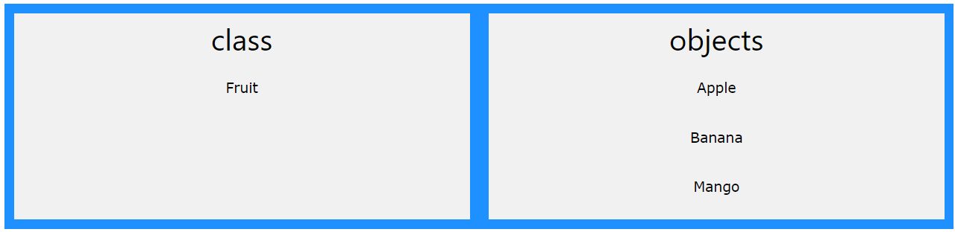
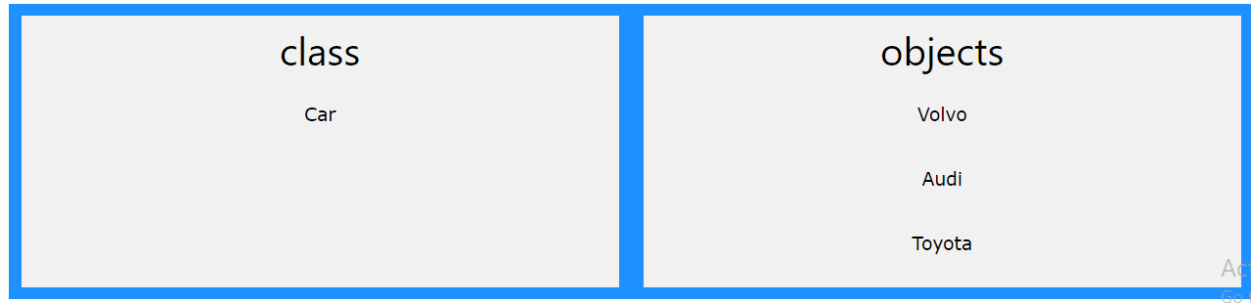

Slide 6
In Java
Java is an object-oriented programming language.
Everything in Java is associated with classes and objects, along with its attributes and methods.
For example: in real life, a car is an object. The car has attributes, such as weight and color, and methods, such as drive and brake.

Slide 7
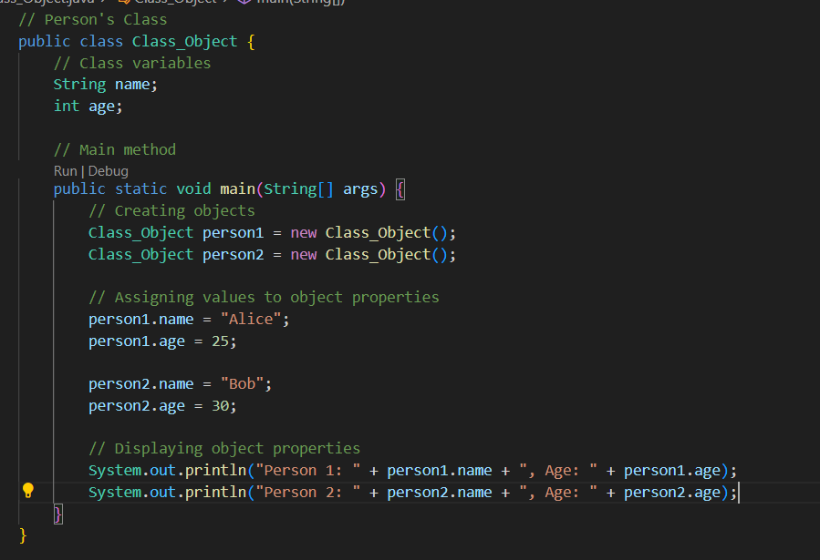

Slide 8
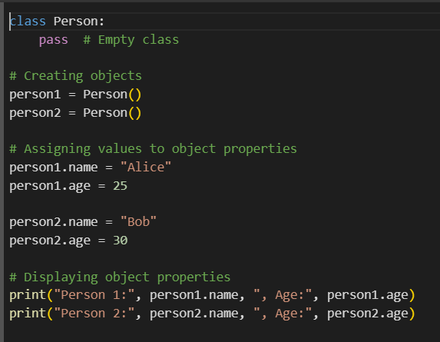
In Python

Slide 9
Task
Student Information: Create a class Student to represent student information with properties like name, rollNumber, and grade. Create objects for two students and display their information.
Book Details: Define a class Book with properties title, author, and ISBN. Create two book objects and print their details.
Rectangle Dimensions: Implement a class Rectangle to store the dimensions (length and width) of a rectangle. Create two rectangle objects and display their dimensions.
Car Information: Create a class Car with properties like make, model, and year. Instantiate two car objects and print their details.
Employee Records: Define a class Employee to store employee information, including name, designation, and salary. Create two employee objects and display their records.

